Slide 1

FINAL REVIEW
WIPRO
VIVEK KUMAR
VI40032384

Slide 2
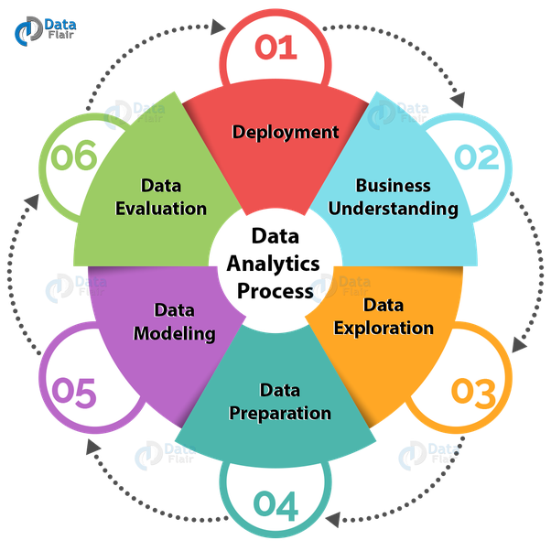
Analytics
Data analytics is a process of inspecting, cleansing, transforming and modelling data with the goal of discovering useful information, informing conclusions, and supporting decision-making.
Data Analytics process : -
OLTP
ETL
DWH
Reporting
Data Centric Approach
Data Center Exit
Data Lakes on Cloud

Slide 3





BUSINESS INTELLIGENCE TOOLS
Bi Tools
Looker
Tableau
SAP BI
Microstrategy
SAS BI
SiSense

Slide 4






Projects
1. Data Consumption Roadmap.
2. Dashboard on Looker.

Slide 5
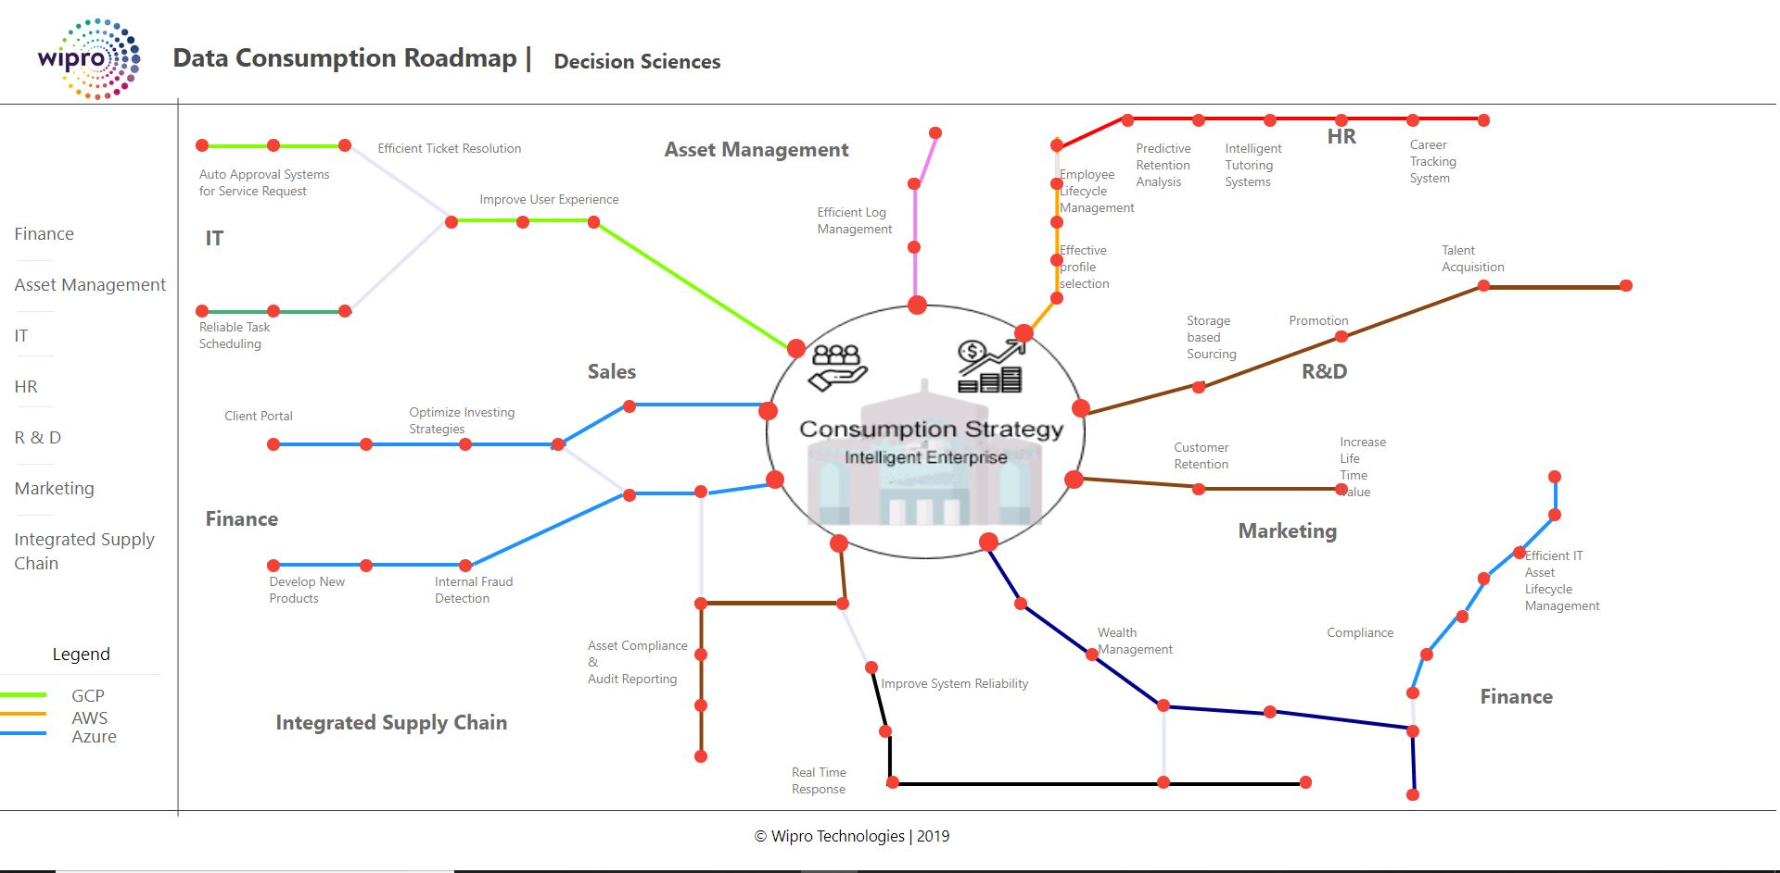
Data Consumption Roadmap Webpage

Slide 6
Data Consumption Roadmap Webpage
The main output of data strategy will be a project roadmap that shows you how to use technology to meet your business goals.
This roadmap identifies the projects that have the biggest impact for your business and likely the biggest return.
TASK : To create a webpage of the roadmap for the data consumption strategies which are loaded just once and one can navigate it’s parts within it and making it interactive.
The interactivity is provided in conjunction with control flow so each choice will display the specified details to customer.
Technologies used : - HTML, CSS, JavaScript.

Slide 7
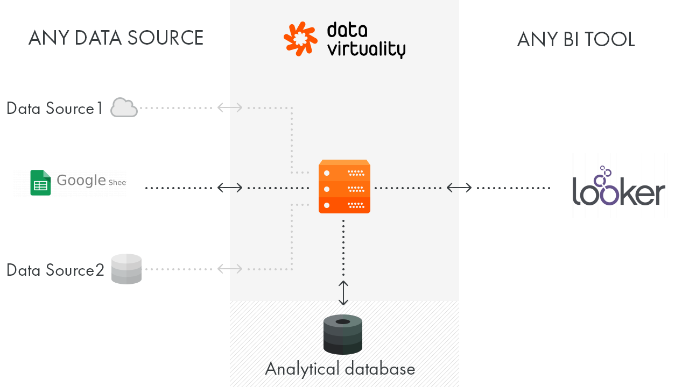
2. Custom Dashboard on Looker
Objective : - To generate the custom visualizations of Enterprise Data on Looker.

Slide 8
Roadmap for Solution
Data Consumption Roadmap Webpage
Custom Dashboard on Looker
Obtaining the content
Creating Internal Pages
Creating Index Page
Connecting Components
Final Webpage
Obtaining Dataset
Importing custom visualization from D3Js
Importing dataset to Big Query
Creating Connections, Models and Views
Dashboard on Looker

Slide 9
Project Analysis
Progress So Far :
Front End development using HTML5, CSS3, JavaScript.
Embedded Sankey Diagram into Looker.
Created dashboard on Looker with custom dataset.
BI tool used : - Looker
Technologies Used : -
Big Query.
Google Sheets
Future Scope :
1. Applying Machine Learning
on the data.
2. Creation of Real time
visualization of data
depending upon user input.

Slide 10
THANK YOU

